Slide 1
Underground Environment Representation in MUDDI
Josh Lieberman & Scott Simmons
23 January 2018

Slide 2
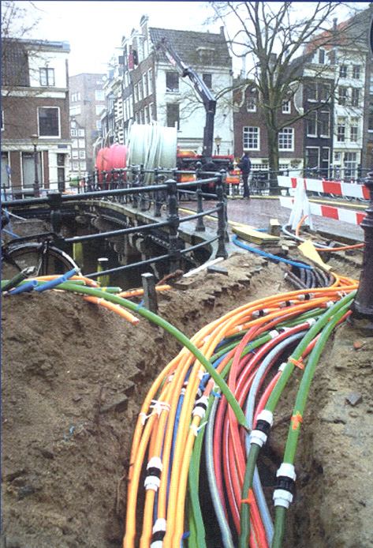
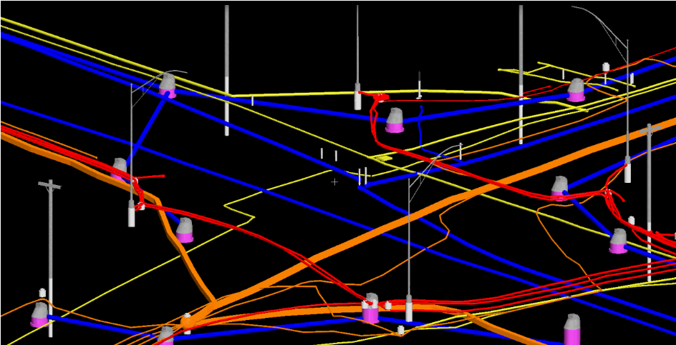
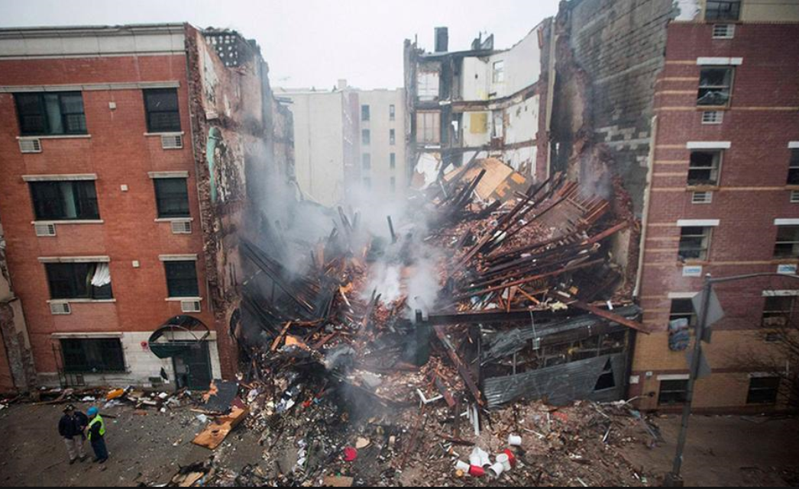
Underground Infrastructure Information (UGII) – Current State of Affairs –
Present UGII data quality is poor
Different data models
Stored in different ways
Different geometry and semantics
Inability to exchange UGI data
Maintainers have different purposes
Ownership, governance challenges
Interoperability issues
Costs of UGII failures are recognized
Routine excavations can be disastrous
Inefficiencies in construction
Unable to predict cascading failures
OGC Underground Concept Development Study Report
http://docs.opengeospatial.org/per/17-048.html

Slide 3
Use cases and perspectives
Data Use Cases
Routine street excavations
Emergency response
Utility maintenance programs
Large scale construction projects
Disaster planning and response
Smart cities programs.
Data Perspectives
Data integration
Visualization – 2D, 3D, 4D, AR
Data quality, consistency, alignment
Dependency analysis
Digital twinning and simulation / predictive modeling
Notes:
Many reasons why underground data is critical.
Each use case requires a particular perspective or set of perspectives
Each perspective requires the appropriate geometric constructs, feature attributes, and interrelationships
Some use cases (e.g. excavation) require relatively simple and simply represented data, although it needs to be complete and accurate in 2D.
Some of the most compelling use cases (e.g. emergency response, disaster planning) require relatively complex and accurate data, such as functional dependencies

Slide 4
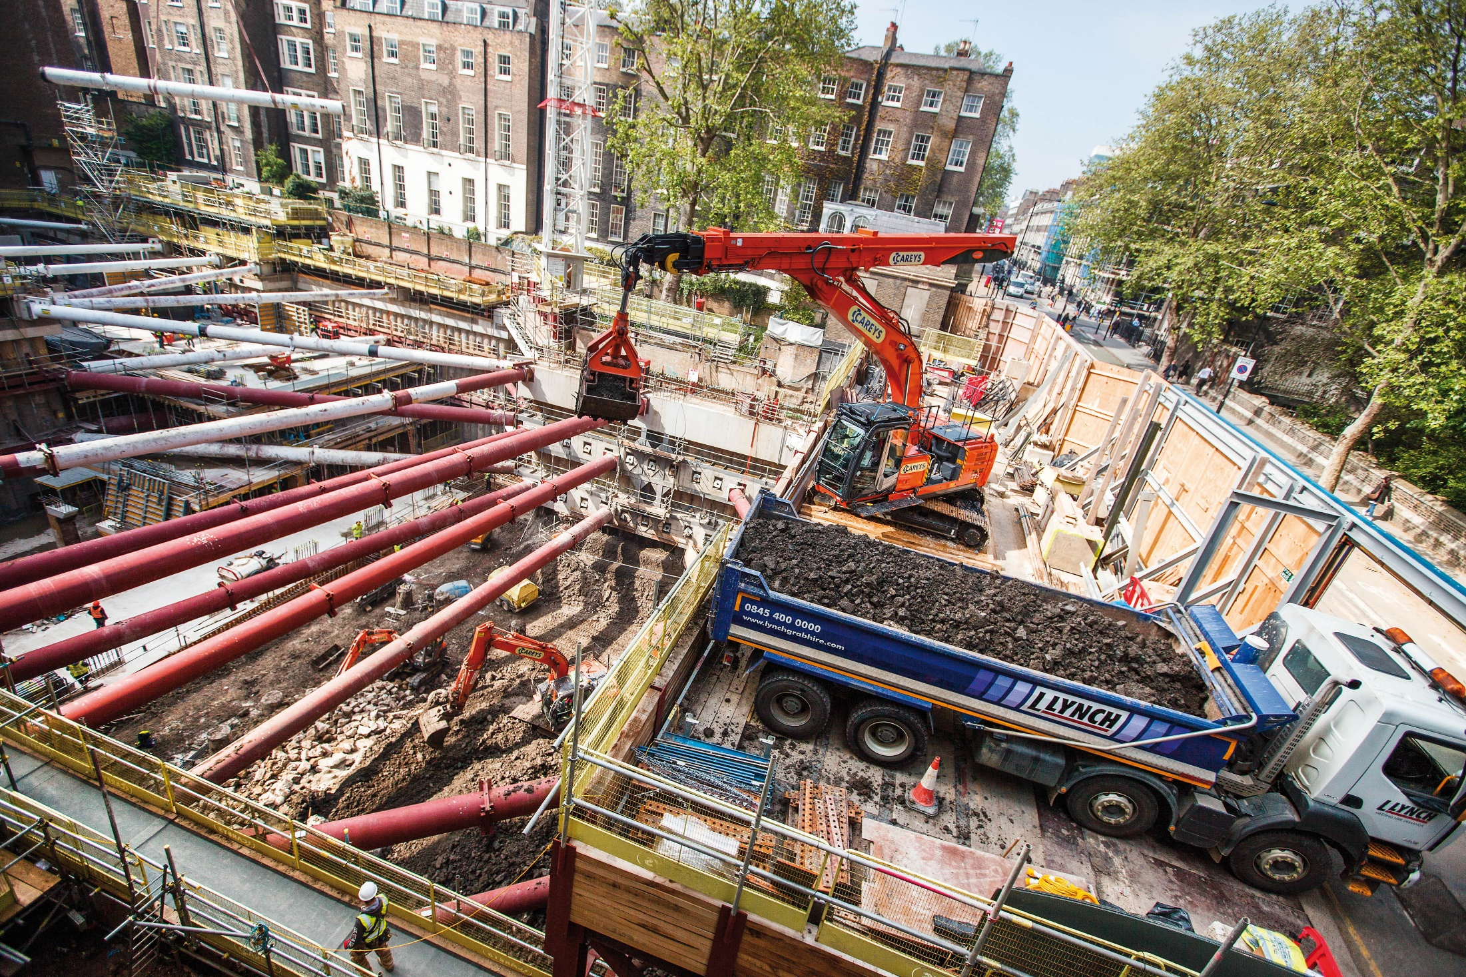
Notes:
Deodatis – Columbia: too often the underground infrastructure is conceptualized as hanging space, just temporarily hidden by ground, pavement, etc.

Slide 5
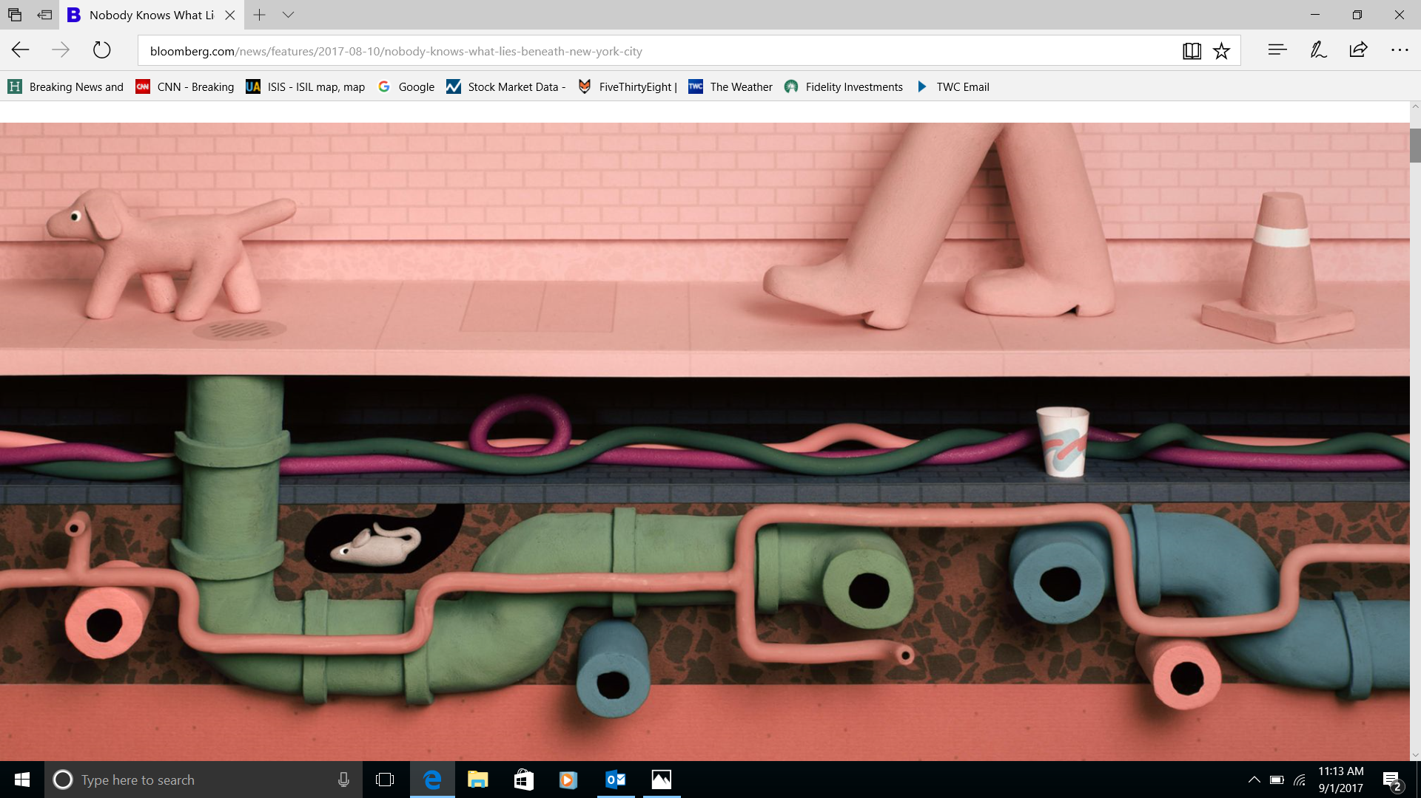
“Nobody Knows What Lies Beneath New York City” Greg Milner Bloomberg Businessweek, 8.10.17
https://www.bloomberg.com/news/features/2017-08-10/nobody-knows-what-lies-beneath-new-york-city
Notes:
The underground environment is not just structures hanging in space.
It is a complete whole that resists gravity, upholds ground-level and above-ground city structures, contains below-ground structures such as subways, and provides the pathways for water, air, and other materials to move and transform.
Nobody knows what (and where) is built beneath a (New York) city, nor what it is built in. At least infrastructure has typically a standard form such as a pipe, but the forms of geology, hydrology, pedology in the underground environment are endlessly variable according to natural and artificial influences.

Slide 6
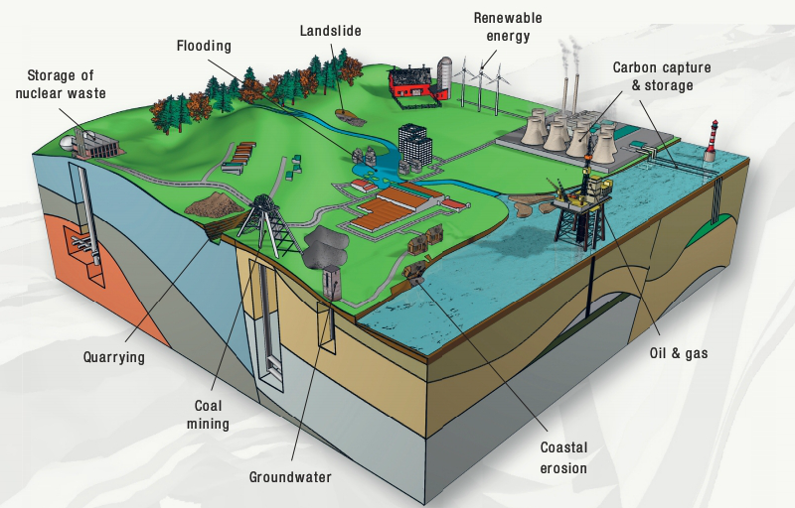
Geological properties & processes matter
Underground structures, properties and hazards affect where, and how, to build most effectively
The Institution of Civil Engineers estimate that about 50% of cost and time over-runs on civil engineering projects are caused by 'unforeseen ground conditions.‘
Dense urban environments = conflicting demands on the subsurface
Holistic approach needed to avoid developments being considered in isolation
Infrastructure is affected by, and affects, dynamic, complex, underground mass and fluid processes
Groundwater
Contamination
Heat
Shrink / swell
Sink holes
Weathering and corrosion
Notes:
MUDDI (Model for Underground Data Definition and Integration) focuses for now on representing the underground environment in relation to infrastructure, but those relationships can still be very complex, depending on original geologic processes, long periods of construction, demolition, and reconstruction, as well as the dynamic effects of groundwater, surface processes, chemical and biological transformations, e.g. rotting pilings, subsidence, erosion, development of leakage pathways

Slide 7
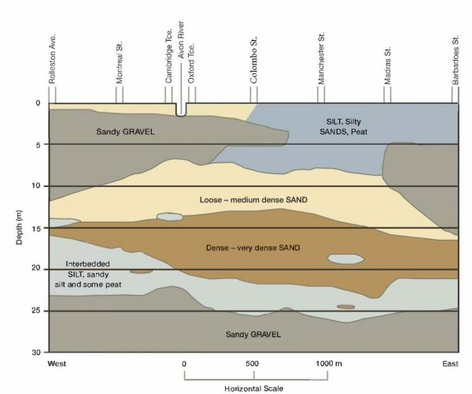
Soil Heterogeneity in 2D.
Notes:
Just looking at soil in 2D shows the potential complexity. Equal complexity extends in the 3rd dimension. Most of the above geometric shapes and associated boundaries are interpreted from lithological variation and may or may not correspond to variation in engineering properties, hydrology zones, or chemical characteristics.

Slide 8

Reference underground environment models
BGS National Geological Model
GeoSciML
EarthResourceML
INSPIRE Geology
GeoTOP
GroundwaterML
SoilIEML
Models are designed for different purposes (engineering, water management, hazard assessment). The model intents need to be understood to allow for meaningful translation and combination between them.

Slide 9
Underground environment for engineering
A variety of study perspectives (may be overlapping):
Geology – study of deposited / intruded / precipitated earth materials and their structures, particularly how they got that way.
Pedology – just the soils created by insitu weathering and bio-transformation
Hydrology – underground environment as a segment of the water cycle
Geo(logical) engineering – leveraging geologic knowledge for engineering purposes
Engineering geology – deriving engineering properties from geologic knowledge
Geotechnical engineering – determining engineering properties of earth materials with respect to design requirements
A variety of spatial geometric perspectives (may co-exist / overlap)
“Continuous field” – voxel perspective (complete but not insightful)
Visual – surface mapping / boring / interpretive cross-section perspectives
Unit – geologically interpreted units, contacts, structures
Earthwork – regions determined by engineering role and/or ownership
Bedding – immediate environmental contexts such as fill volumes around a sewer pipe
Notes:
A wide (wild) variety of model perspectives are required to properly represent knowledge of the urban underground.

Slide 10
Drawing from GeoSciML / Inspire

Slide 11
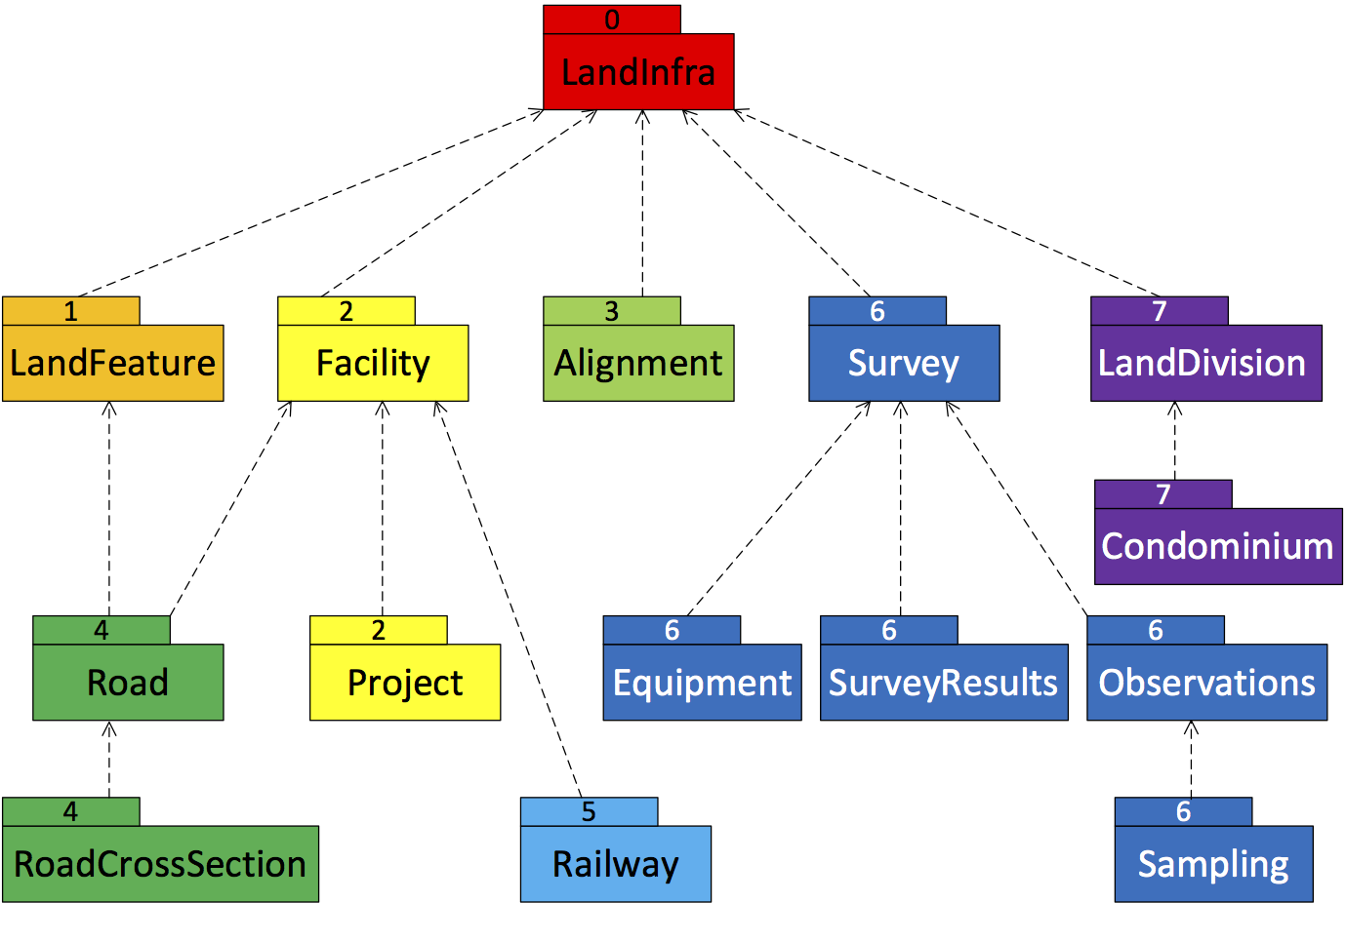
Drawing from LandInfra

Slide 12
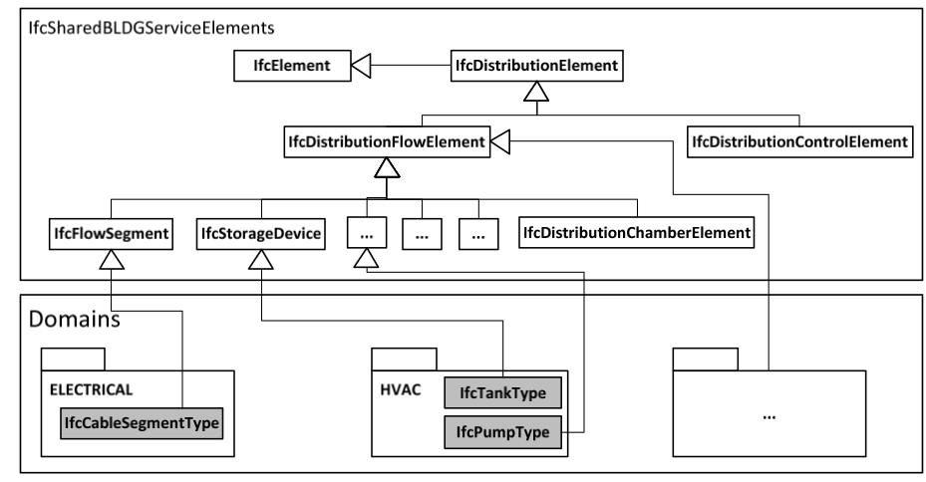
Drawing from IFC
Geotechnical Extension

Slide 13
MUDDI integration opportunities
Notes:
Targeted at levels of commonality and detail that would be relevant to underground infrastructure data integration.

Slide 14
Model Patterns
Specialization Adaptation Relation
Structure
Network Element
Attribute 1
Attribute A
Method X
Network
Structure
Attribute 1
Attribute 2
Network
Link
Electrical
Component
ConnectTo
Attribute 1
Attribute 2
Attribute 3
Attribute A
Method X
Node
Partof
Notes:
Three ways of representing connections between features:
Specialization – from general to specific, but carries along all attributes
Adaptation (MUDDI interfaces, GeoSciML abstract blocks) adds attributes and operations where needed without as much baggage
Relation: topological or functional relationships between features, such as in a network, or composite

Slide 15
MUDDI Model Structure
Surveys
Core Structures
2D Geom
Inputs
3D Geom
Sensors
Data Quality
CityGML
BIM - IFC
Network Structures
Network
Graph
Assets
Environment Regions
Supply Regions
Specialized
Structures
Outputs
Section
Control Function
Containers & Supports
Borehole
Engineering Parameters
Input / Output / Detail Interfaces
Core Model Elements
Notes:
Everything is a structure
Some structures are networks / part of networks
Some structures are defined regions of underground geology / hydrology / chemistry
Some structures mainly contain or support other structures
Interfaces support specific attributes of structures and/or enable specific types of operations
Spatial:
Core structures have identity and location for asset management
2D interface adds 2D extent (plus elevation) for excavation design
3D interface adds 3D geometric entities for construction design, modeling, etc.
CityGML interface provides access to data as CityGML for modeling and visualization
BIM-IFC interface provides access to data as Industry Foundation Classes for engineering and O&M
Engineering parameters could represent geotechnical properties as well, but this is not presently shown
Utility networks
Structures are networks, links, or nodes
One network can be part of or subordinate to another network
Nodes can have internal networks
Links can connect nodes of the same or different networks (interlinks)
Network graph interface adds connections between network structures
Supply regions interface adds 2D / 3D supply region geometries with inputs and outputs (e.g. a substation circuit )
Control function interface adds operational functions and status

Slide 16
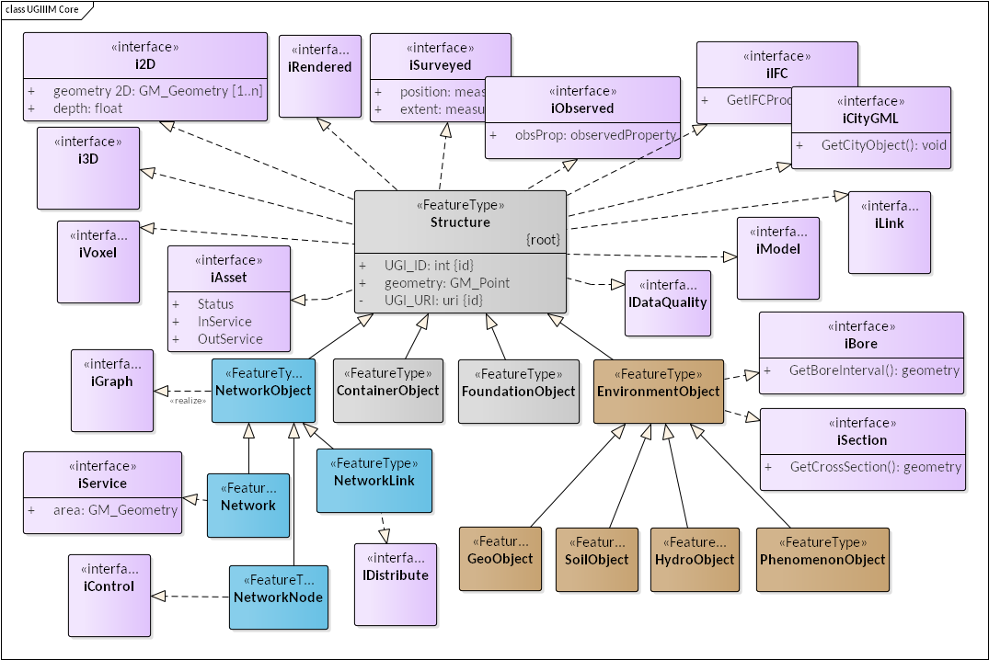
Core MUDDI Model
Notes:
MUDDI allows for defining any needed environment object, with arbitrary 2D / 3D geometry and optional borehole / x-section interfaces, then subdivided into material types which may partially overlap with each other in space (e.g. curved geo-object, inclined water table, horizontal soil unit, roll-front redox zone). Geotechnical properties are not currently represented in a conceptual interface but could be added for mapping to specifically geotechnical data models.

Slide 17
Implementation Strategies
Encodings
CityGML
Simple Features SQL
FME interchange format
JSON-LD
Datastores
Separate tables for object subtypes, interfaces
Unique column entries for each object tuple
Key-value graphs
Pathways
Start with core structure data, add interfaces and specializations as applications require
Start with full complexity, create simplified views where data exists
Designs
Federation of data providers and consumers
Virtual federations on common IT infrastructure
Centralized repositories of authoritative underground data

